Slide 1

Thach chau primary school
Welcome to class 4A1

Slide 2
Wednesday, March 25rd 2017
English 4 Unit 17: How much is the T – shirt?
Lesson 2: 1,2,3
Warm up: Brain storming

Slide 3
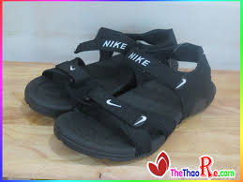
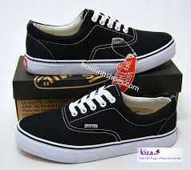
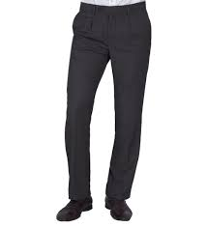
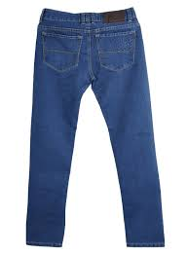
Wednesday, March 25rd 2017
English 4 Unit 17: How much is the T – shirt?
Lesson 2: 1,2,3
I. Vocabulary
Jeans: quần bò
Trousers: quần
Shoes: giày
Sandals: dép quai hậu

Slide 4
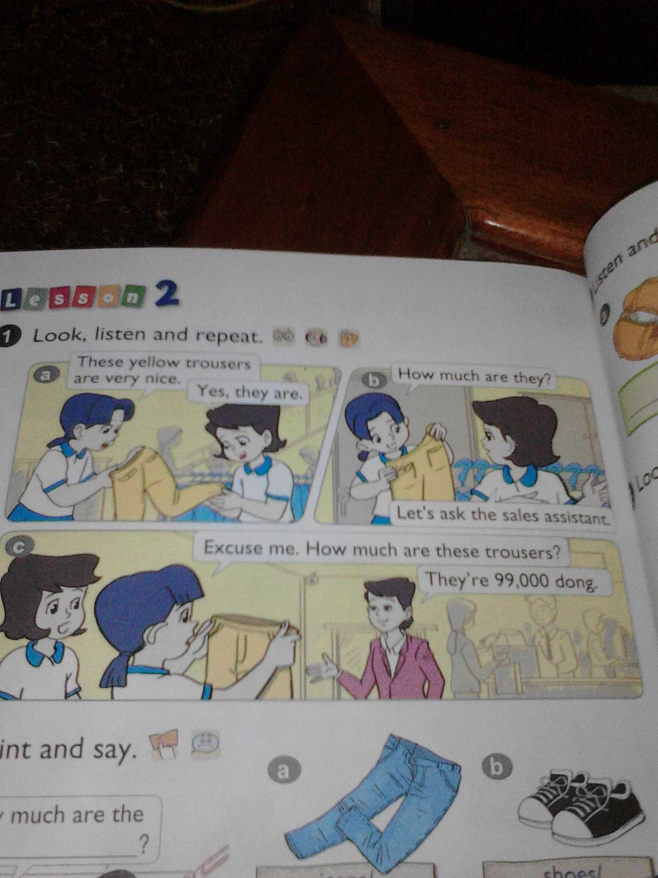

Slide 5
Wednesday, March 23rd 2017
English 4 Unit 17: How much is the T – shirt?
Lesson 2: 1,2,3
II. Grammar
How much are the trousers?
Chiếc quần giá bao nhiêu?
They are 99.000 thousand dong .
Nó có giá 99.000 đồng

Slide 6
Wednesday, March 23rd 2017
English 4 Unit 17: How much is the T – shirt?
Lesson 2: 1,2,3
III. Practice
Shoes / 93.000 dong
Jeans / 75.000 dong
Trousers / 98.000 dong
Sandals / 85.000 dong

Slide 7
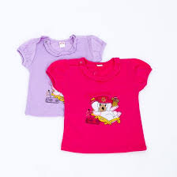

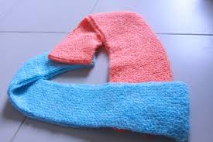
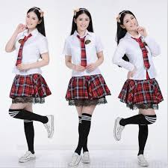
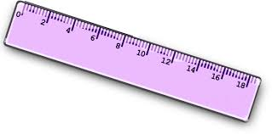

IV. Talking
2000
50.000
100.000
2.500
4000
150.000

Slide 8

Goodbye
Thanks for attending

